Slide 1

Recurrent Chunking Mechanisms for Long-Text Machine Reading Comprehension
51215901104杨光

Slide 2
Introduction
machine reading comprehension (MRC) problems
given a document and a question, the goal is to extract a span from the document

Slide 3
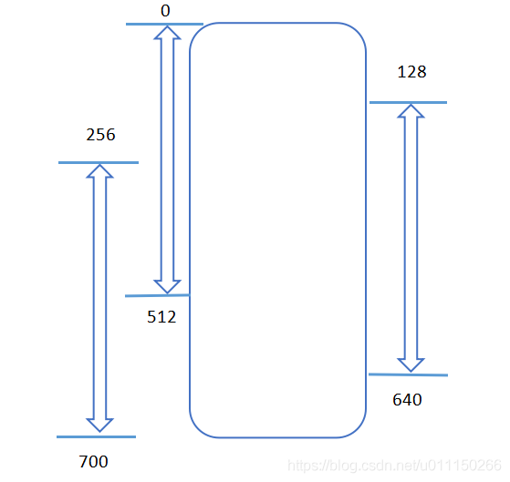
State-of-the-art models tend to use a pretrained transformer model (e.g., BERT) to encode the joint contextual information of document and question.
These transformer-based models can only take a fixed-length (e.g., 512) text as its input.
To deal with long text inputs, a commonly used approach firstly chunks the input text into equally spaced segments (e.g., stride size=128), secondly predicts the answer for each individual segment, and finally ensembles the answers from multiple segments.

Slide 4
First, a predetermined large stride size for chunking may result in incomplete answers, and we observe that models are more likely to fail when the answer is near the boundaries of a segment, compared to the cases when an answer is in the center of a segment surrounded by richer context.
Second, predicting answer for each segment independently may cause incomparable answer scores across segments.

Slide 5
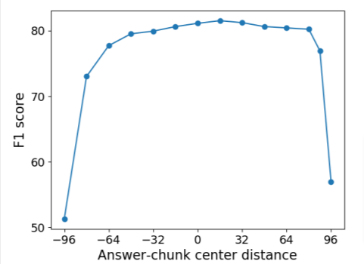
The influence of the distance between the center of the answer span and the center of the segment. The test performance (in F1 score) is evaluated on CoQA using a BERT-Large reader

Slide 6
The proposed recurrent chunking mechanisms(RCM) are built upon the pre-trained BERT models.
propose a chunking mechanism for machine reading comprehension to let a model learn to chunk lengthy documents in a more flexible way via reinforcement learning.
apply recurrence to allow information transfer between segments so that the model can have knowledge beyond the current segment when selecting answers.

Slide 7
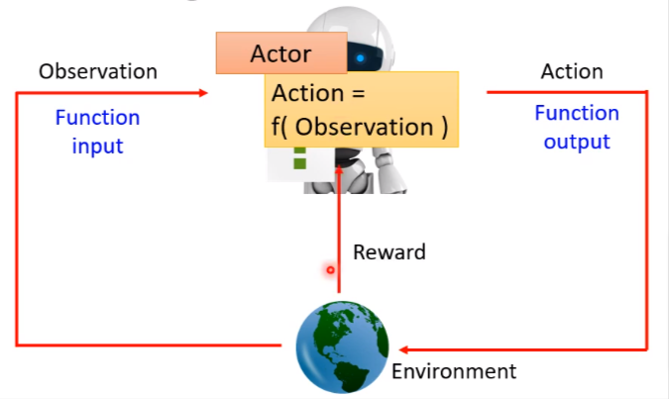
Reinforcement Learning(RL)

Slide 8
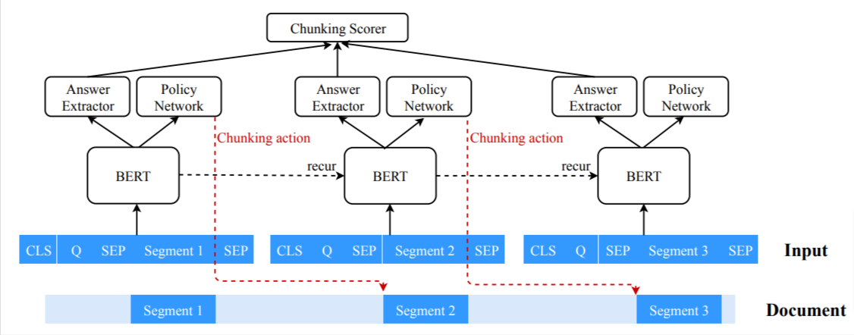
Method

Slide 9
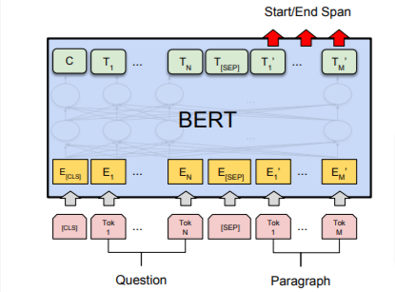
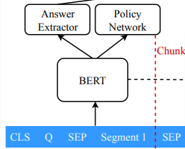
Basic Model
The input for each document segment starts with “CLS” token, which is followed by question tokens “Q” and document segment tokens. We use “SEP” token as a separator between the question and the segment. We also append a special “UNK” token at the end of the segment to handle unanswerable questions.

Slide 10
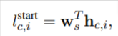
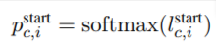
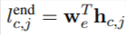
Basic Model
BERT first generates a vector representation h_{c,i} for each i-th token in the c-th segment. Given h_{c,i}, the model scores each token in terms of its likelihood of being the start token of the answer span. Likewise, the model scores how likely the answer ends at the j-th token in segment c.

Slide 11
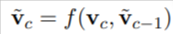
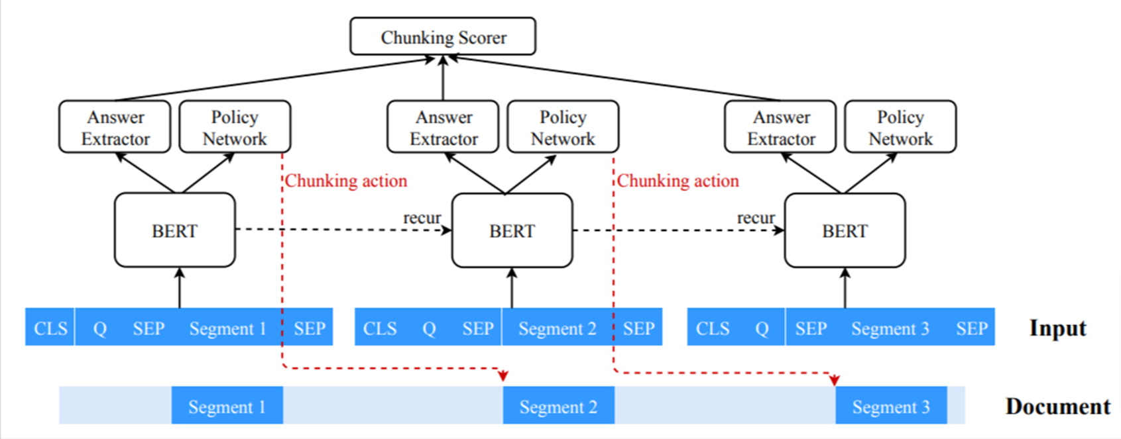
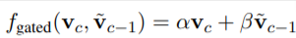
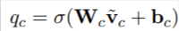
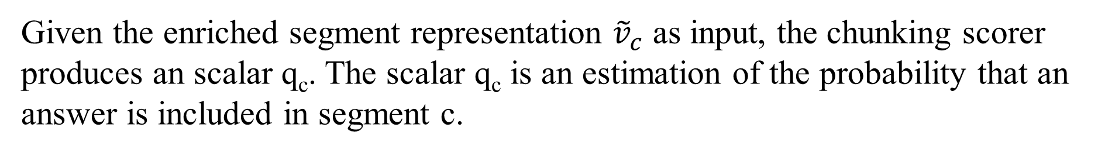
Recurrent Mechanisms
For an input sequence containing the segment c, BERT’s representation for its first token “CLS” is taken as the local representation v_{c} of the segment.
The segment representation is further enriched with the representations of previously generated segments via recurrence.
Given the enriched segment representation ${\tilde{v}}_{c}$ as input, the chunking scorer produces an scalar q_{c}. The scalar q_{c} is an estimation of the probability that an answer is included in segment c.

Slide 12
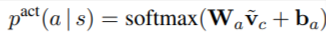
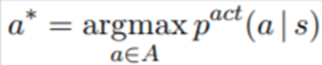
Chunking Policy
The chunking policy gives the probability p^{act}(a | s) of taking an action a at the current state s, which is modeled by a one-layer feedforward neural network.
The action a is the stride size and direction (forward or backward) the model chooses to move to the next document segment. We define the action space A as a set of strides, e.g., A = {−16, 16, 32}.
We define the state s of the model to be the segments that a model has processed up to the current segment c, i.e., s = {1, 2, . . . , c}.

Slide 13
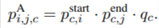
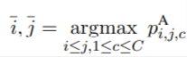

Slide 14
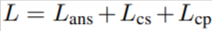
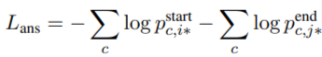
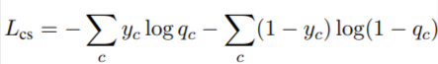
Training
Supervised Learning

Slide 15
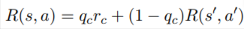
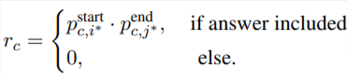
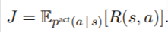
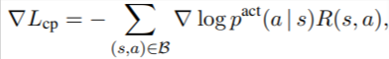
Training
Reinforcement Learning for Chunking Policy

Slide 16
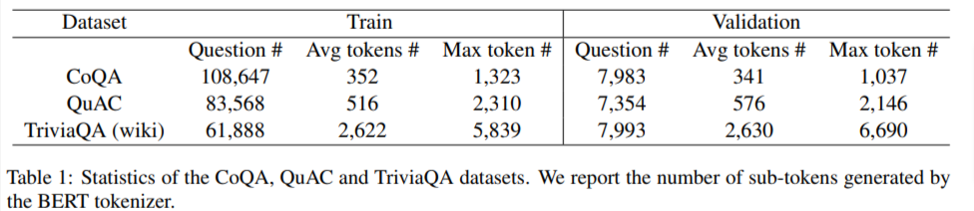
Experiment
action space: [−16, 16, 32, 64, 128] for CoQA, [−16, 32, 64, 128, 256] for QuAC and [−64, 128, 256, 512, 1024] for TriviaQA

Slide 17
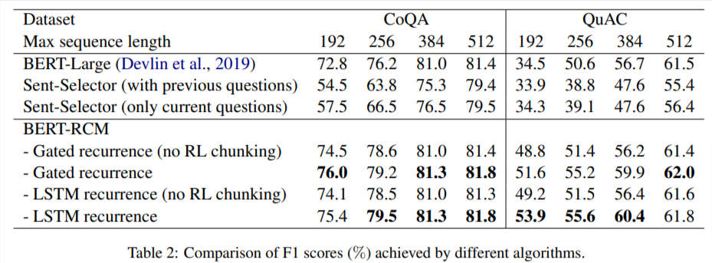
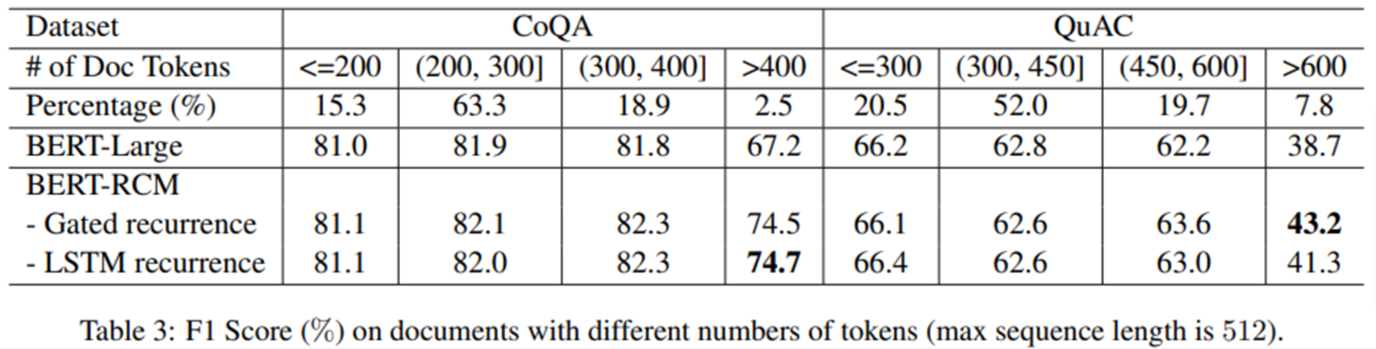
generates 4, 3, 3, and 2 segments under the length limit of 192, 256, 384, and 512

Slide 18
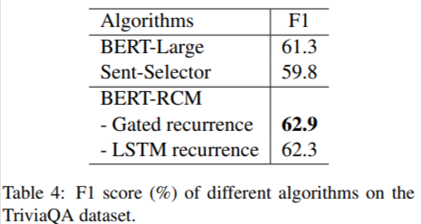
the maximum number of can extract from a document is 3

Slide 19
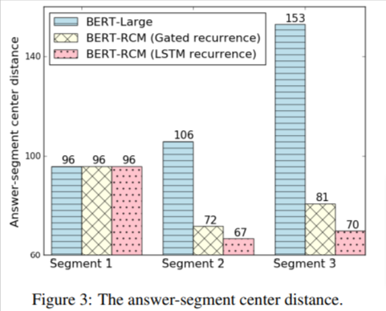
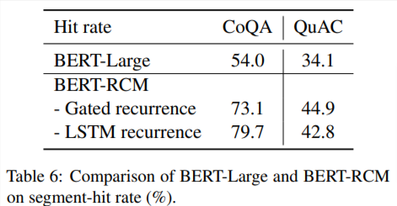
To evaluate how well a model can capture good
segments, we use hit rate, i.e., the percentage of segments that contain a complete answer among all extracted segments, as evaluation metric.

Slide 20
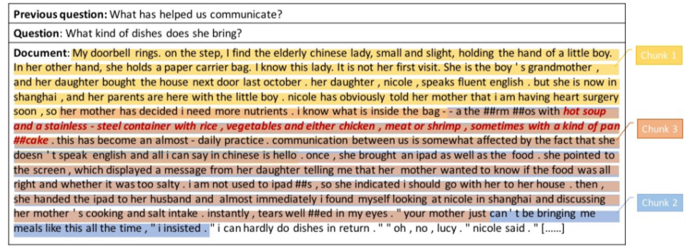

Slide 21

Thanks

